Slide 1







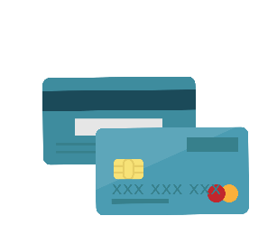
We aspire to be the LEADING PROVIDERS of INNOVATIVE AND IMPACTFUL SOLUTIONS that solve diverse and complex problems in the DIGITAL PAYMENTS and FINANCIAL SERVICES Sectors the World Over.
Open Wallet Management System
An Omni Channel Solution for Consumer & Business Digital Wallets

Slide 2

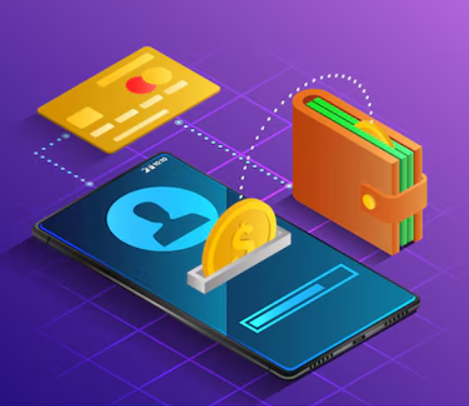
Content
Paysys Digital Wallet Management Solution
01
OpenWallet Overview & Architecture
02
OpenWallet Features
(Financial & Non-Financial)
03
OpenWallet Back Office

Slide 3
OPEN WALLET OVERVIEW & ARCHITECTURE

Slide 4

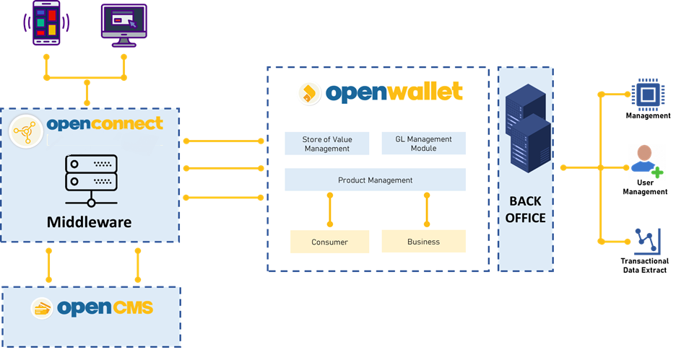
OPEN WALLET ARCHITECTURE
Open Wallet Overview & Architecture
An omni-channel solution for hosting both consumer and business based mobile money accounts/ store of value.
Limit Management
Easy to manage channels & account limits
GL Module
A separate GL module for managing financial transactions
KYC Sets
Sets can be made to group attributes together
Product & fee Management
A flexible product definition, including definition of taxes and fees
Card Management System
Multi-Transaction Support
Easy to manage channels & account limits

Slide 5
OPEN WALLET FEATURES

Slide 6









WALLET MANAGEMENT SYSTEM
Open Wallet Features
Customer Wallet Creation
Inquiresy & Request
Manage General Ledger
Bank Account/Card Linking
Tax Configuration
OPEN WALLET
Transfers & Payments (Online
, Bill Payment & Top Ups)
Product Management
Bulk Operations (Account Opening, Bulk Credit & Bulk Debit)
Fees & Limit Management

Slide 7
WALLET MANAGEMENT SYSTEM
Open Wallet Features
Wallet Creation
Non Financial Features
Balance Inquiry Wallet
Title fetch
Financial Features
Wallet to Wallet Funds Transfers.
Allows to create Wallet, once created the customer can store and access their funds in the form of digital currency, such as e-cash within the bank's system.
Wallet Statement
Account Linking
Card Linking
Payments (online purchases, bill payments)
Cash Deposit & Withdrawal
Wallet to Account Funds Transfers.
Inter Bank Fund Transfer.

Slide 8
WALLET MANAGEMENT SYSTEM
Open Wallet Features
Product Management
General Ledger
A separate GL module is available for managing the general ledger of all financial transactions
Bulk Wallets Opening
Fee Management
Limit Management
Tax Configuration
Product Definition
Streamlines mass creation of digital wallets.
Enables opening multiple wallets simultaneously.
Reduces manual intervention for bulk wallet setup.
Tailored options for varying KYC requirements.

Slide 9
OPEN WALLET BACK OFFICE

Slide 10
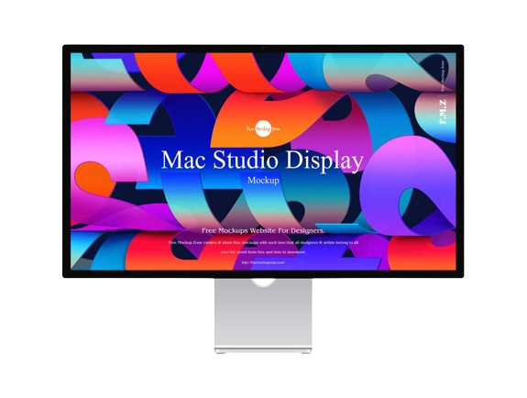
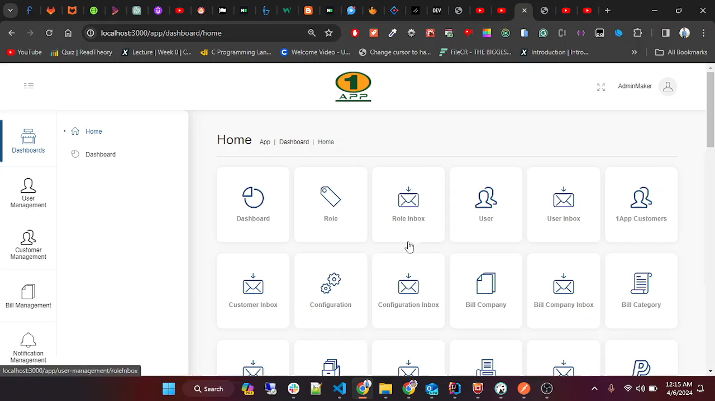
WALLET MANAGEMENT SYSTEM - BACK OFFICE
Fees Management - BACK OFFICE
Fee Management
Fee Calculation
Fee Structure Management
Fee Tracking
Fee Adjustment
Revenue Generation

Slide 11
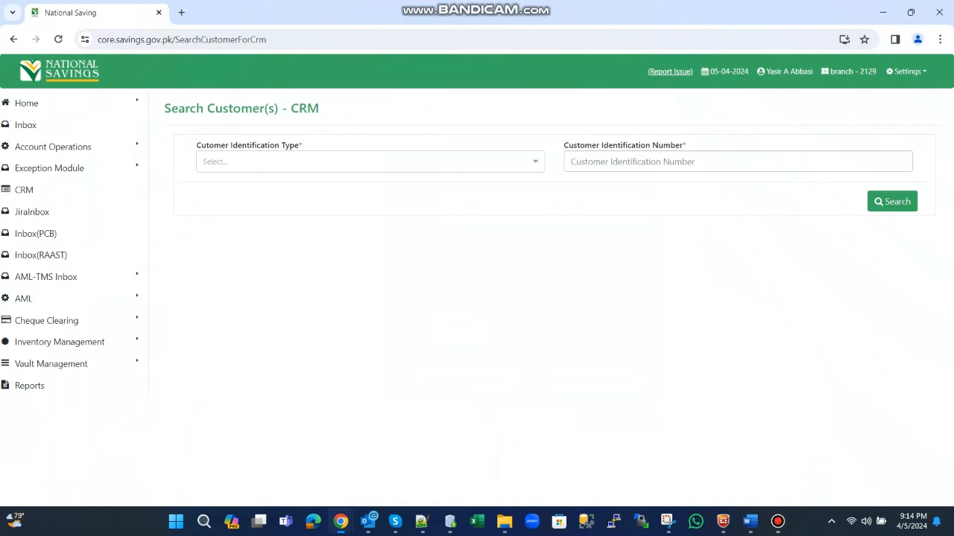
WALLET MANAGEMENT SYSTEM - BACK OFFICE
CRM- BACK OFFICE
CRM
The CRM allows the back office user to view complete details of the customer.
Including: Complete KYC and account related details.

Slide 12
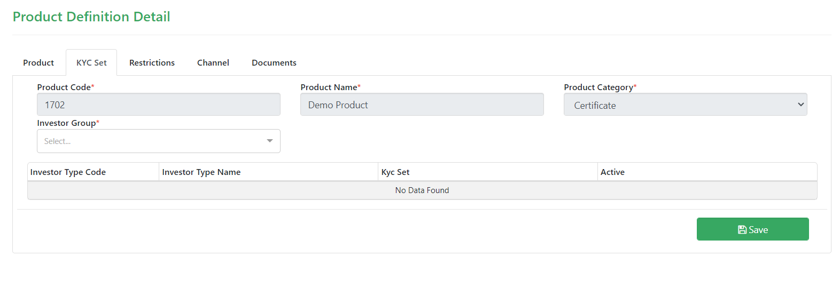
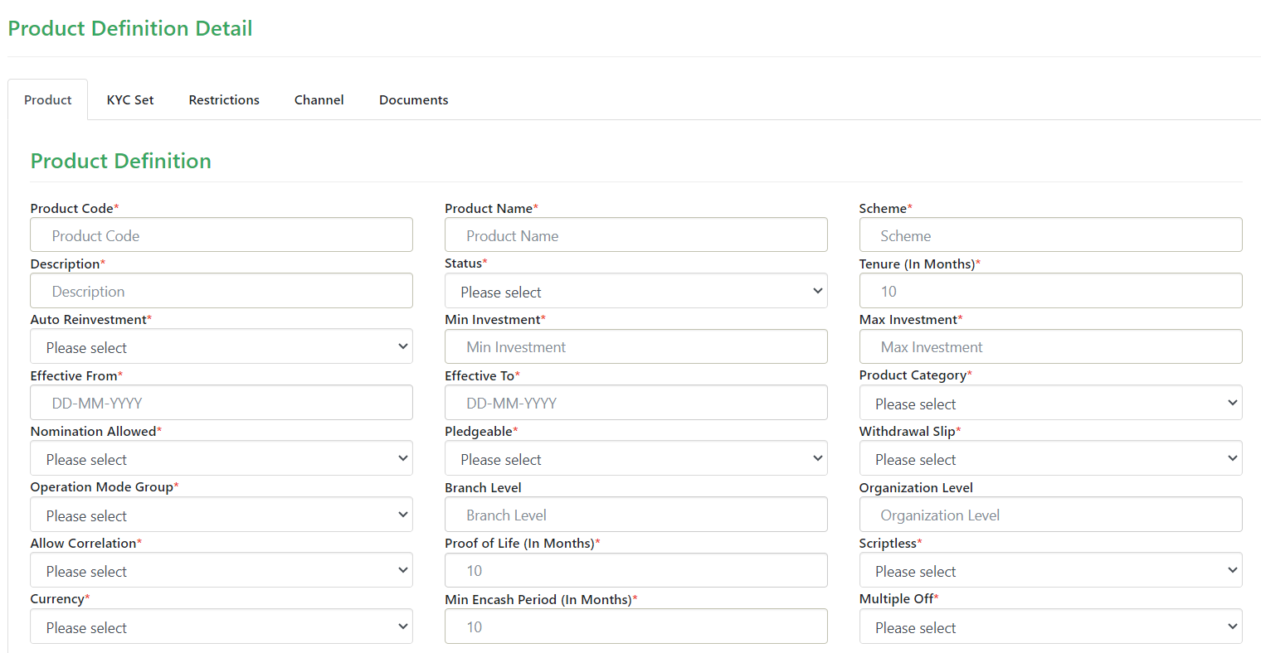
WALLET MANAGEMENT SYSTEM
Product Configuration – Back Office
Create KYC Set & Define Products
Allows to create KYC set & assign to specific product.
Allows to add comprehensive details to each product as definition.

Slide 13
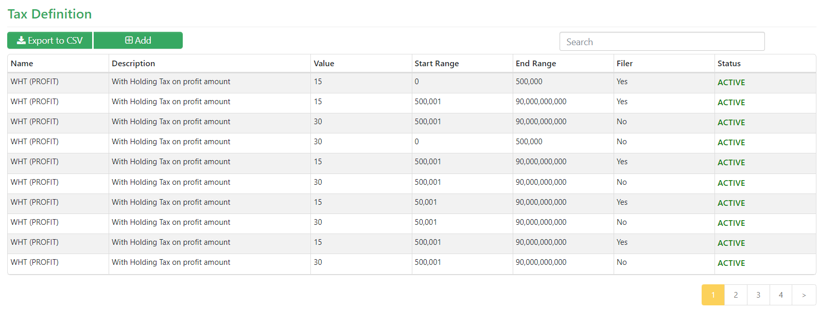
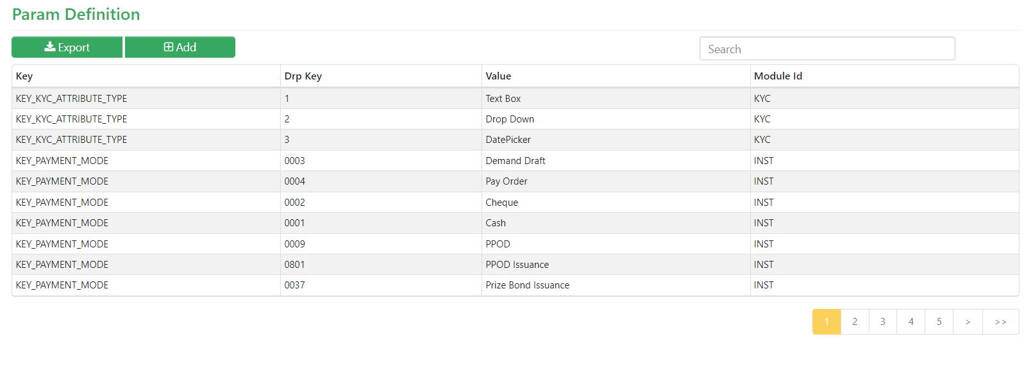
WALLET MANAGEMENT SYSTEM
Product Configuration – Back Office
Tax & Parameter Configuration.
Customize taxation rules and rates for wallet transactions.
Set limits, fees, and other parameters governing wallet operations.

Slide 14
WALLET MANAGEMENT SYSTEM
AML/CFT– Back Office
Life Cycle of Screening of a Customer record
AML/CFT
Comprehensive Coverage: AML system includes NACTA, UNSC, and PEP checks.
Scoring Mechanism: Evaluates customer details against set thresholds.
Suspicion Indication: Customers exceeding thresholds marked as suspect.
Diverse Logic Types: Utilizes various logic types for checks.
Overriding criteria for 100% matches.
Sequential CNIC number matching.
Soundex algorithm for name matching.
Sophisticated Approach: Demonstrates complexity and sophistication in AML logic.
Profile Submitted
Clear By System
Suspect By System
Mark Clear By AML Reviewer
Mark Block By AML Reviewer
Scan by system
Scan by system

